Slide 1
CSE 445 Lecture 8.1
Logistic Regression

Slide 2
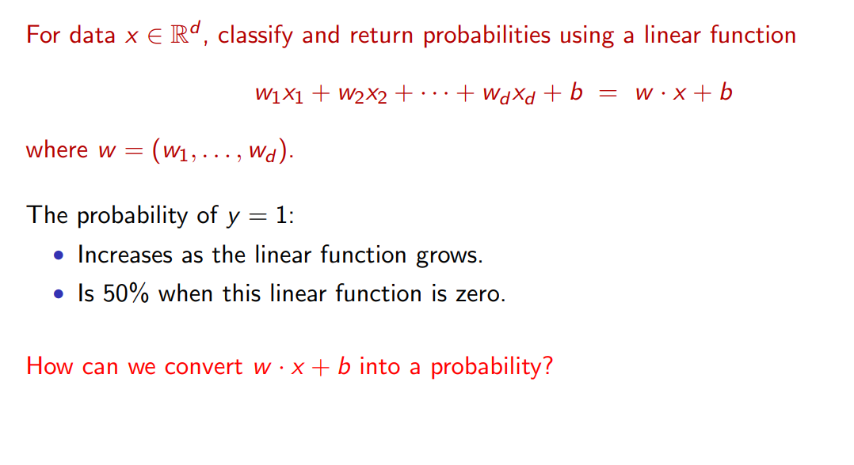
Linear model for cond. Probability estimation

Slide 3
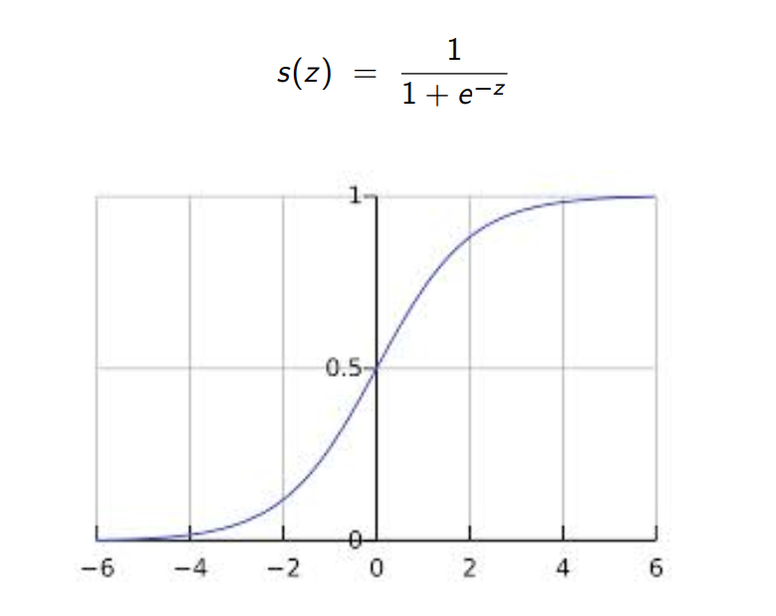
The squashing function

Slide 4
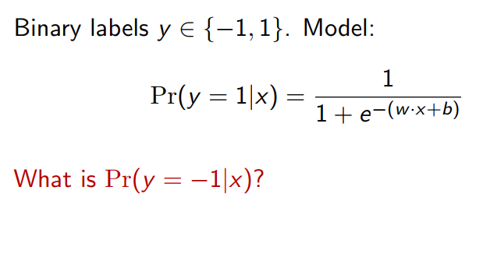
Logistic regression model

Slide 5
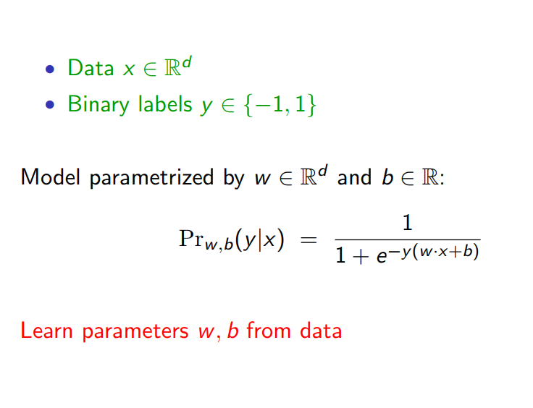
Logistic regression for binary labels

Slide 6
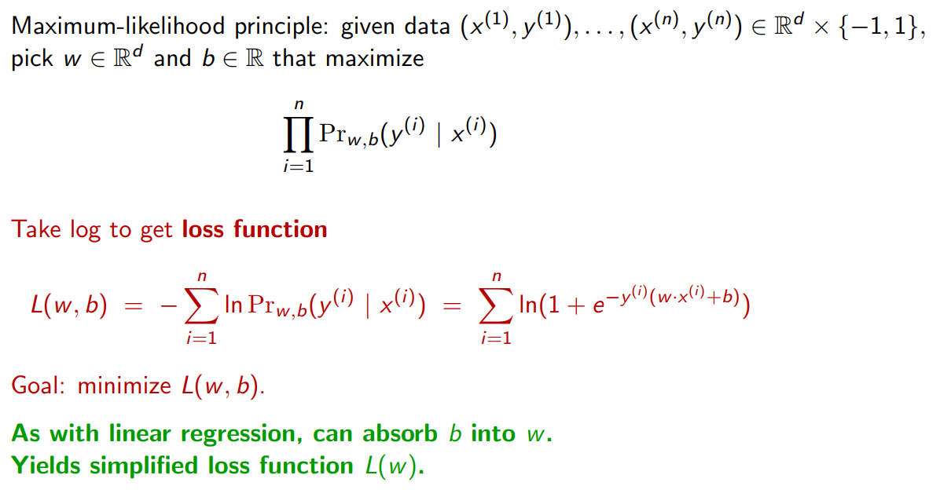
The learning problem

Slide 7
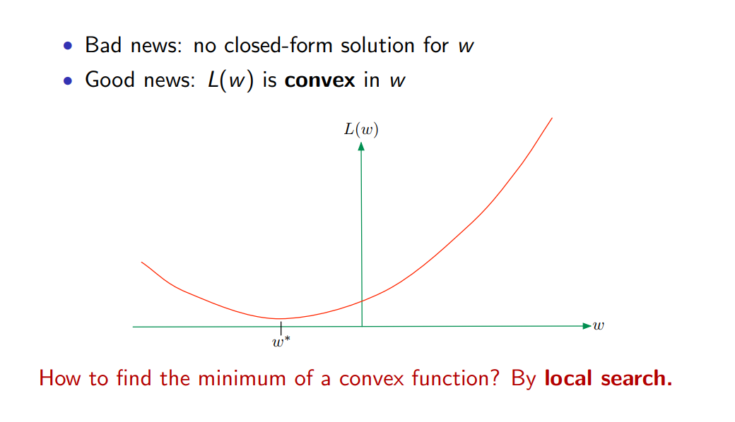
Convexity

Slide 8
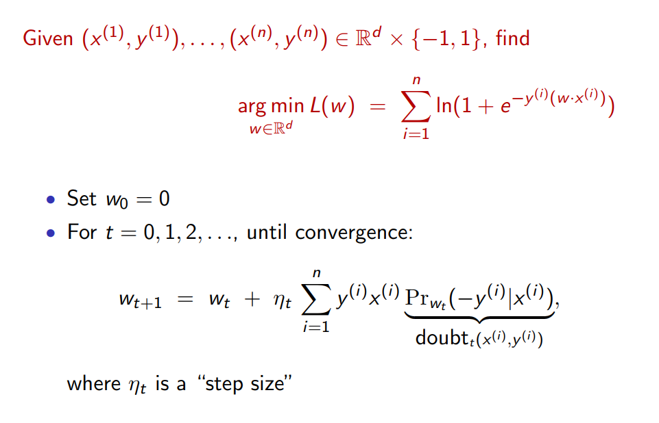
Gradient descent

Slide 9
Use of logistic regression
Text classification
Bag-of-words representation for text
Solution by logistic regression
Margin versus test error
Interpreting the model

Slide 10
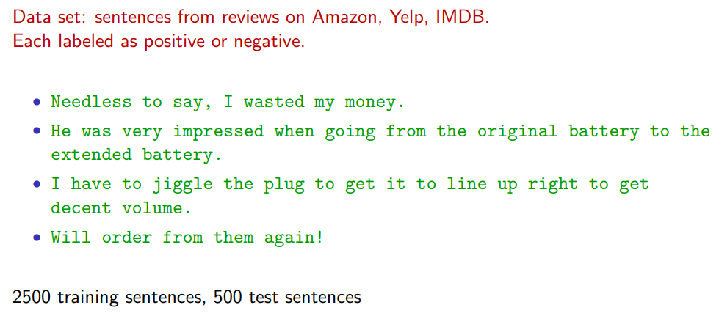
Sentiment data

Slide 11
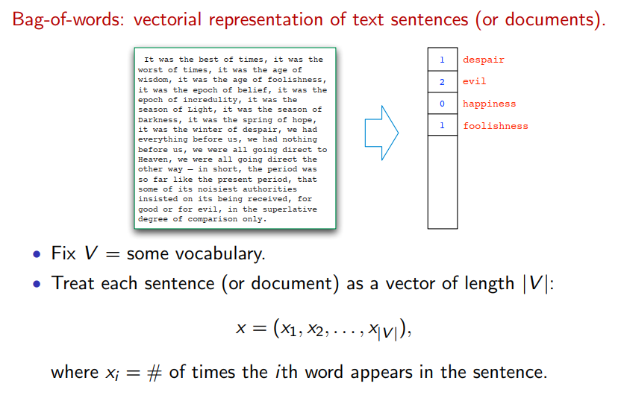
Handling text data

Slide 12
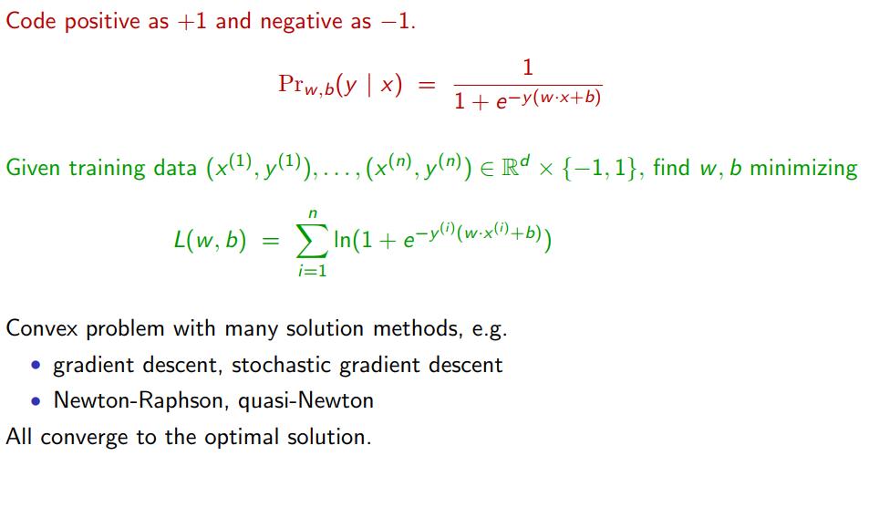
Logistic regression approach

Slide 13
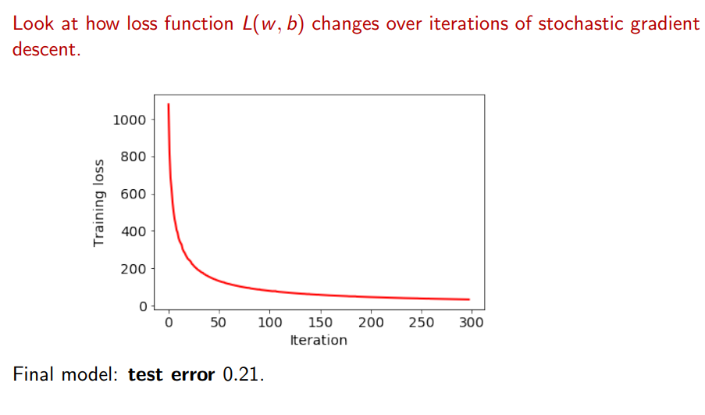
Local search in progress

Slide 14
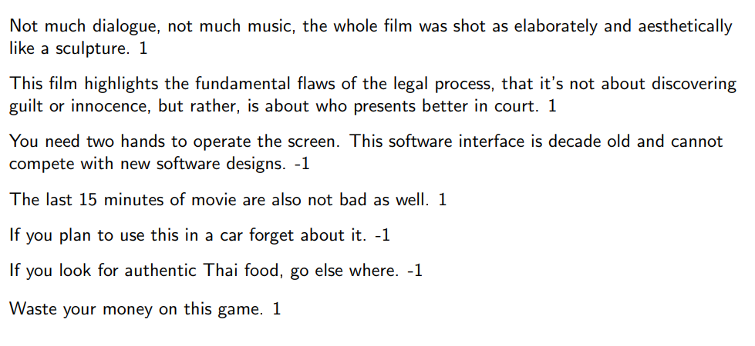
Mistakes

Slide 15
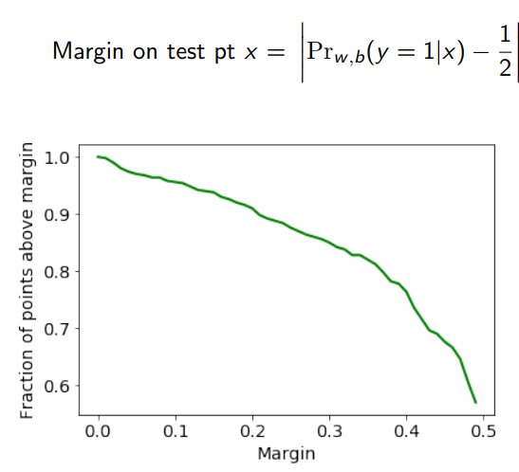
Margin and test error

Slide 16
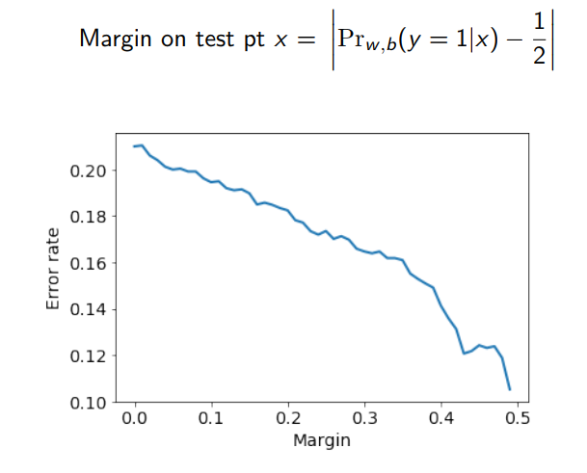
Margin and test error

Slide 17
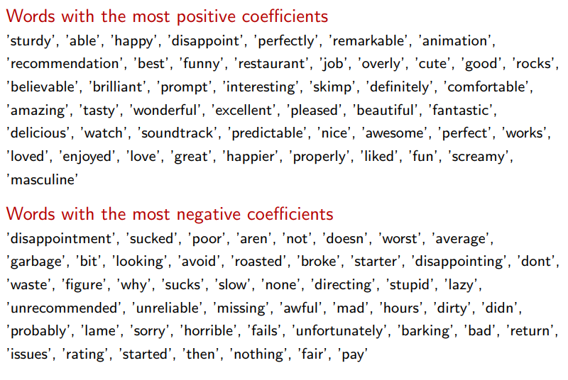
Interpreting the model

